Slide 1
Fourier Series
Emalina and Kristine

Slide 2
Using Fourier Series to solve the following PDE’s:
The one-dimensional wave equation
The two-dimensional Laplace equation
The KdV equation

Slide 3

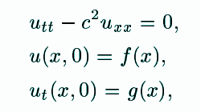
The Wave Equation
Our 1D wave equation is given as
Where u is a function of both space and time, and c is the speed of the wave
The wave equation model the propagation of waves with a constant speed and describes phenomena such as waves on an elastic string, sound waves or light waves in a vacuum.
Since its second order in time, two initial conditions are required to determine a unique solution.

Slide 4
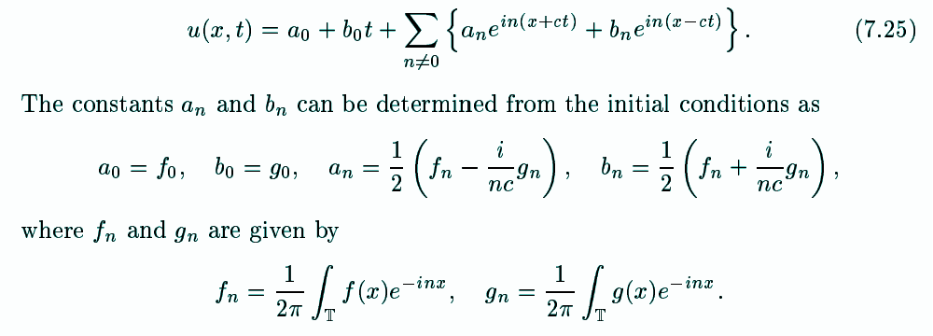


The Wave Equation cont.
The separated solutions of the wave equation that are proportional to e^{inx} :
For n≠0 we have
For n=0 we have
Superimposing these two solutions we get the general solution below:
Notes:
After this slide move to whiteboard to work on solving the wave equation in form of (7.10) on paper notes.

Slide 5
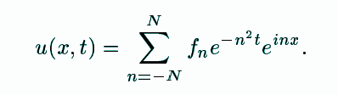
The Wave Equation cont. In comparison to the Heat equation
While the solution to the heat equation smoothes out initial data over time, due to the diffusion process, the wave equation does not.
The solution to the wave equation does not converge to a stationary solution as t → ∞.

Slide 6
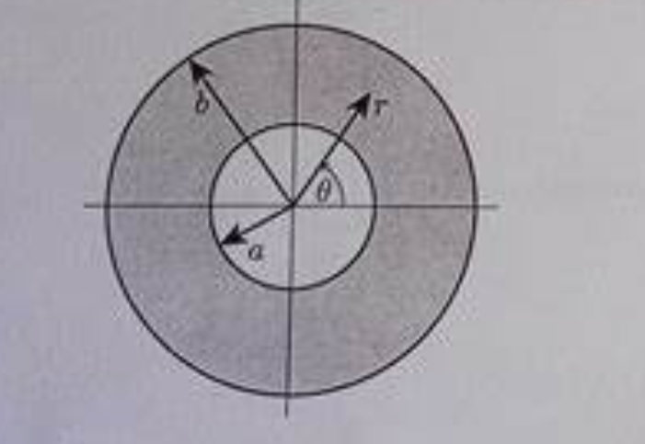
What is Laplace used for?
Laplace is used for a specific area or domain such as a circle
If we had a heated circle
If we knew the boundary conditions we would be able to find the temperature at any point inside the circle
A solution to the Laplace equation can include an infinite sum of terms, but we only need a few to solutions to obtain a good approximation.
Notes:
Next we will focus on 2-dimensional Laplace equation.
If we had a heated metal circle and knew the temperature at every point on the edge we would be able to use the Laplace equation to figure out the temperature at any point inside the circle. In order to solve this we need to use fourier series in order to break down complex wave patterns. Since it is a circle we would also e able to use polar coordinates.

Slide 7
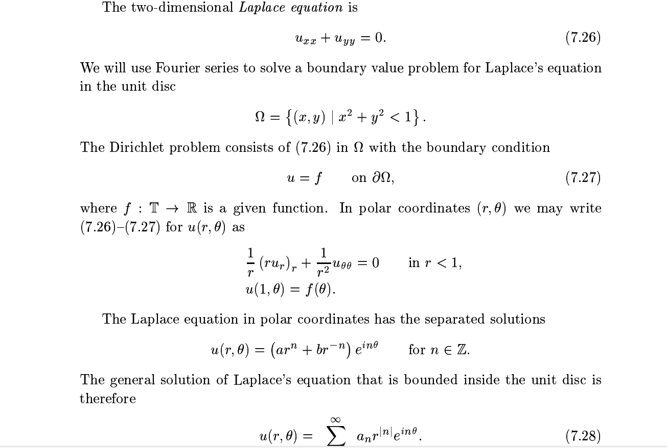
Notes:
We are focusing on the temperature on a flat surface then there shouldn’t be any change as we move around the surface. We are particularly, looking at a flat circle called unit disc. We are focusing on a heated circle where the heat doesn’t focus on one particular spot.

Slide 8
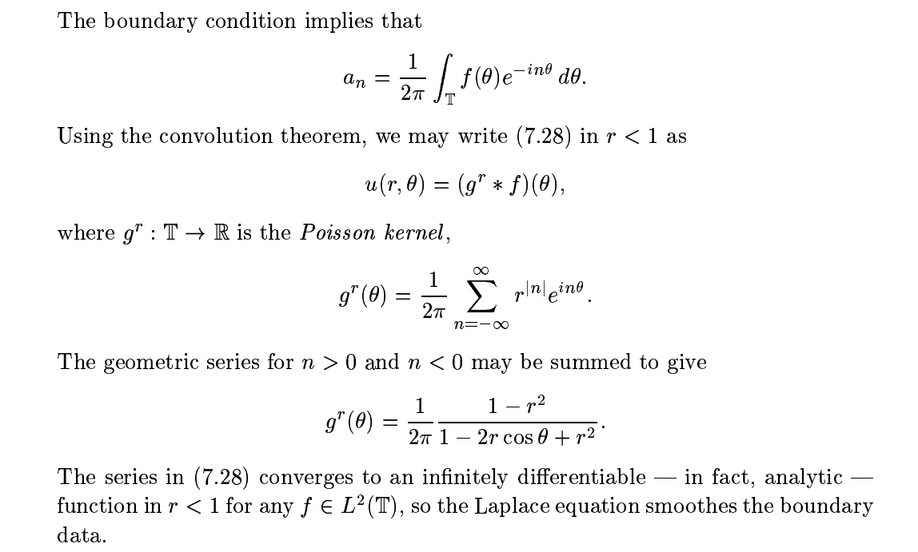
Notes:
Theorem 7.5 (pg 154) Convolution If f,g in L^2(T) then hat(f*g)_n =sqrt(2pi) hat f_n hat g_nwe are combining convolution theorem with Poisson Kernel g^r(theta) with or edge function f to get the general solution u(r,theta)
L^2(T) the solution u(r,theta) will always be a smooth and well behaved in the circle like a smooth pond.

Slide 9

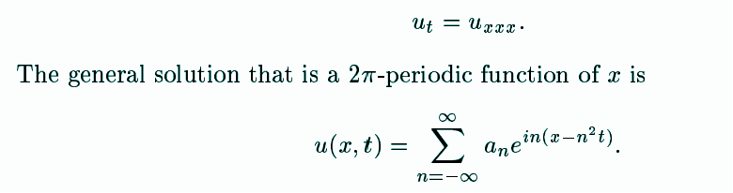
The KdV Equation
The above PDE is used to describe waves on shallow water surfaces. More specifically it describes waves that keep their shape while traveling which is known as solitary waves or solitons.
Although the equation is complex because it involves nonlinearity, it can still be solved with a technique called the inverse scattering method.
However dispersion will be discussed later instead of inverse scattering method.
The component uu_{x} is what makes the pde nonlinear.
Assume that the wave height u is sufficiently small so that the nonlinear component does not influence the solution and we then obtain a linearized KdV equation:

Slide 10
Some other applications of Fourier Series

Slide 11
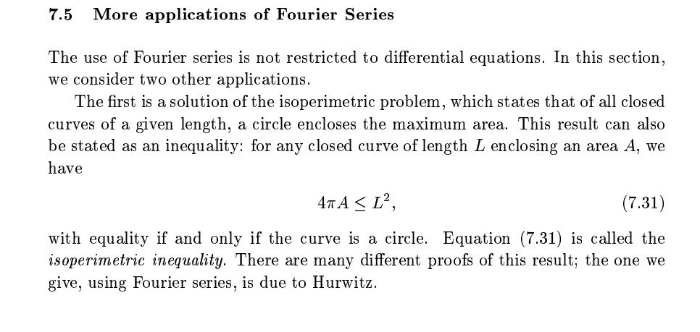
The Isoperimetric problem

Slide 12
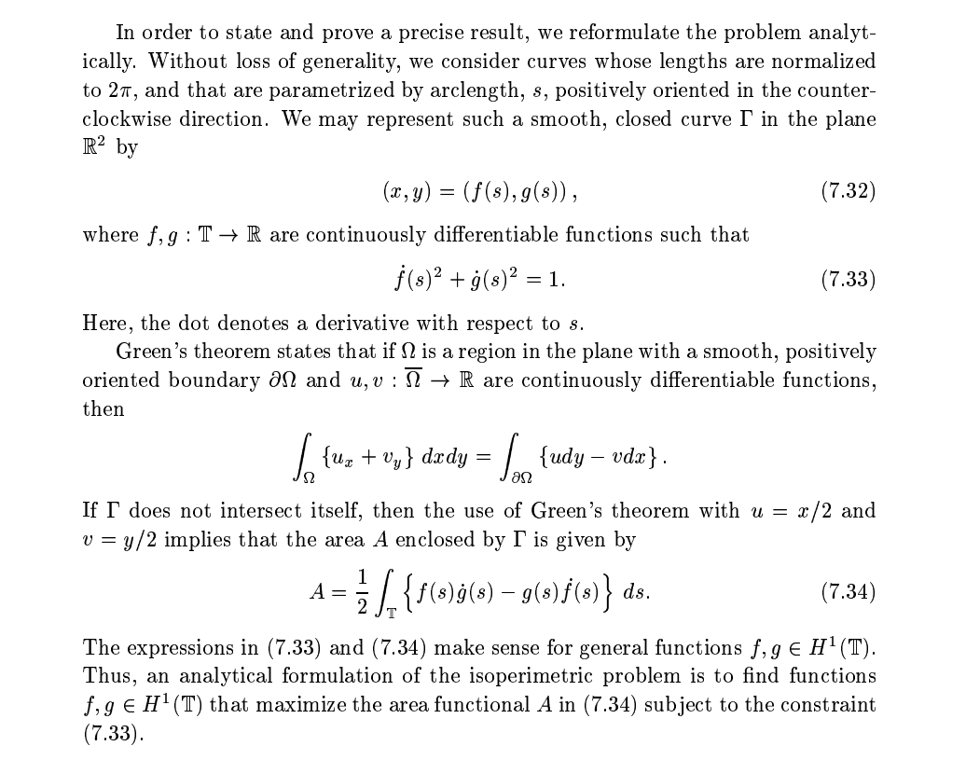

Slide 13
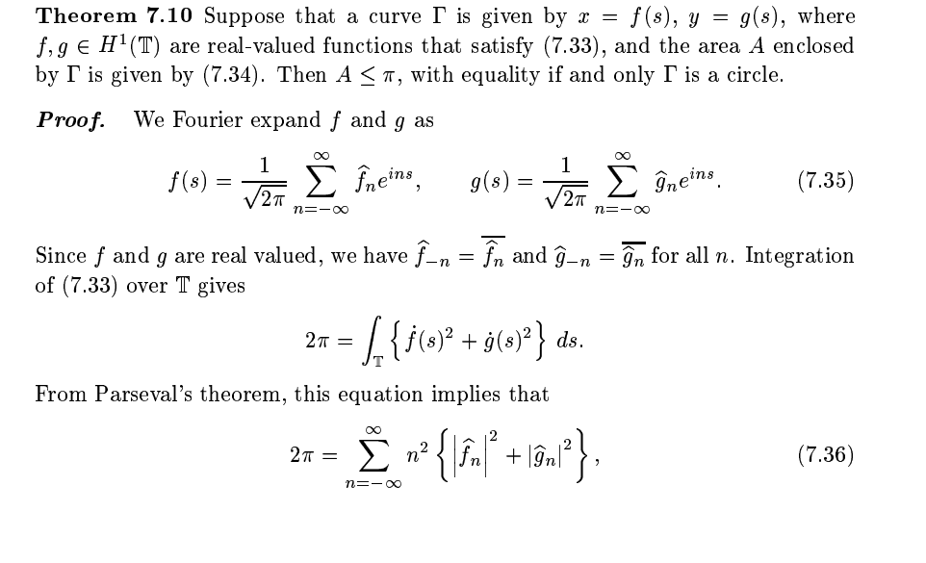

Slide 14
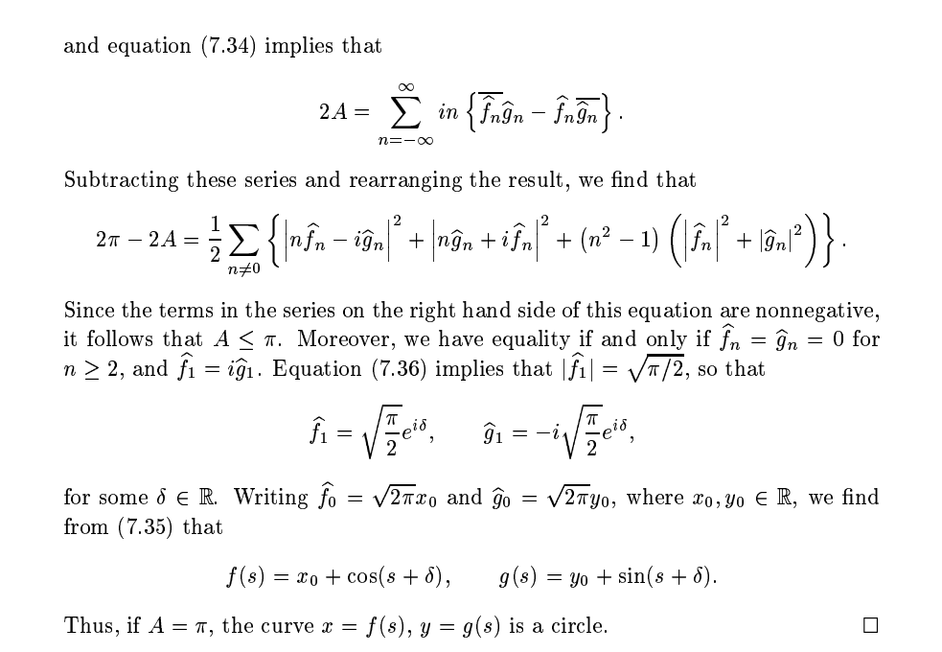

Slide 15
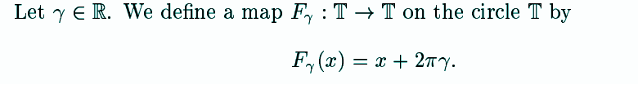
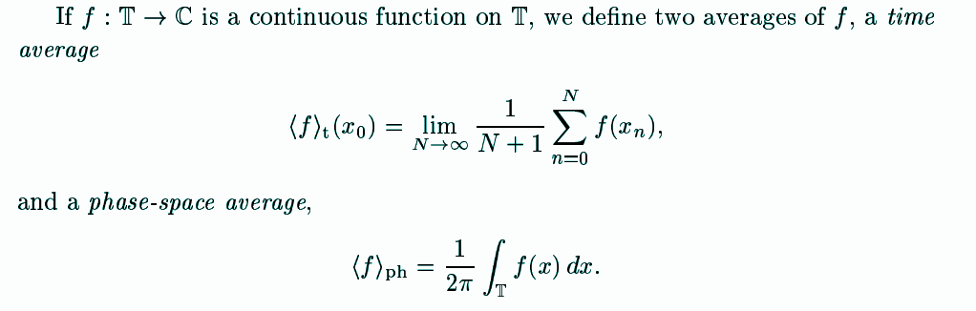
The Ergodic Theorem

Slide 16
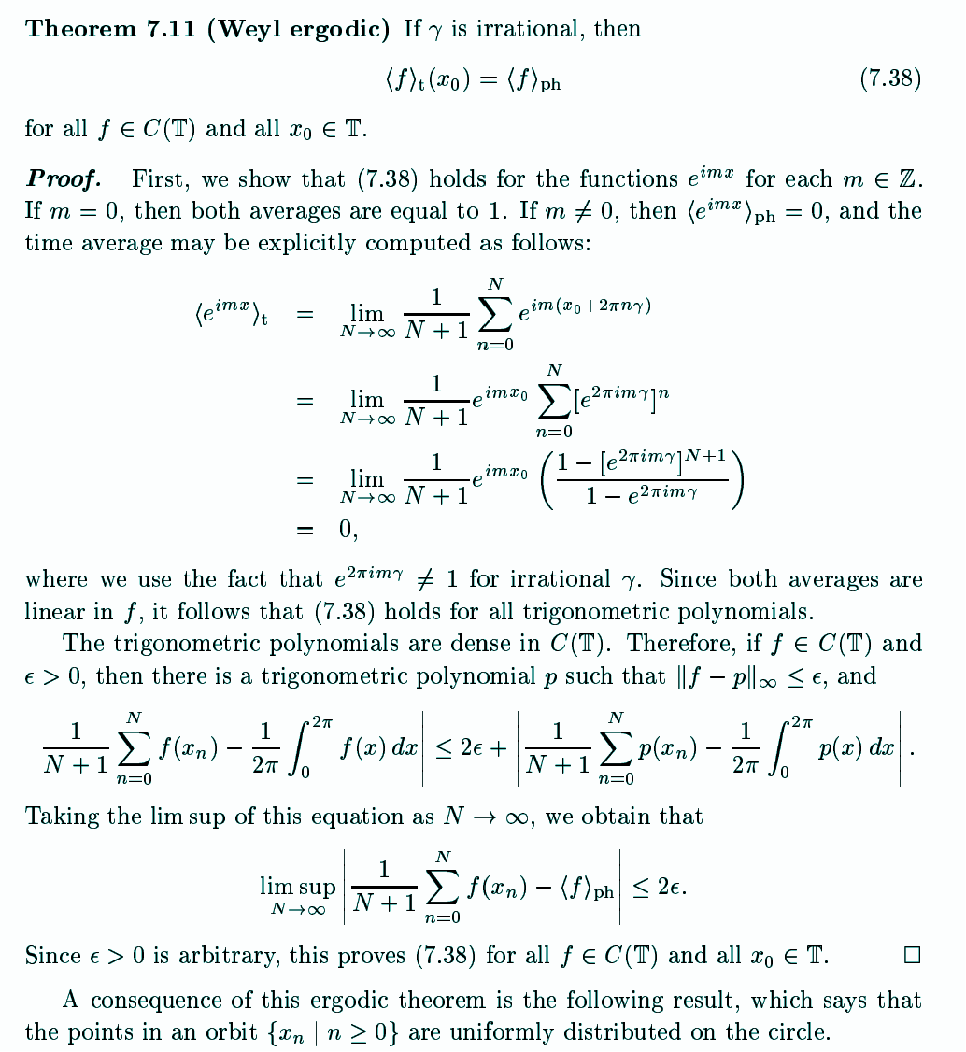
The Ergodic Theorem
cont.

Slide 17
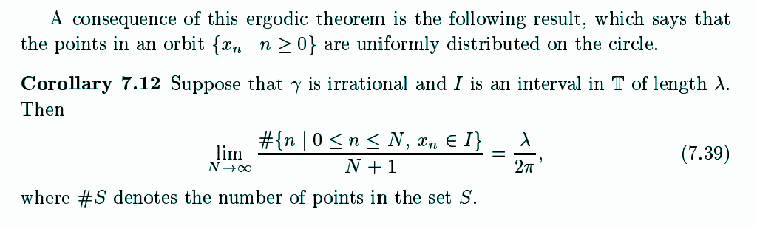
The Ergodic Theorem

Slide 18
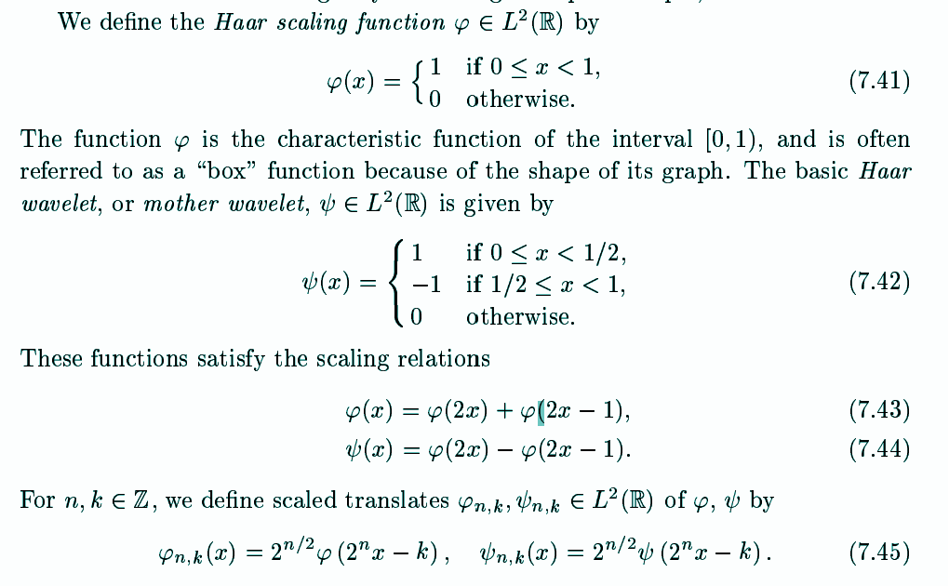
Haar Wavelets
The Haar wavelet is a specific, simple example of a wavelet. It consists of a “scaling function” and a “wavelet function”.
The Haar wavelet can be used to create a basis for L²([0,1]).
This basis forms a complete and orthonormal basis of L²([0,1]).
Multiresolution Analysis

Slide 19
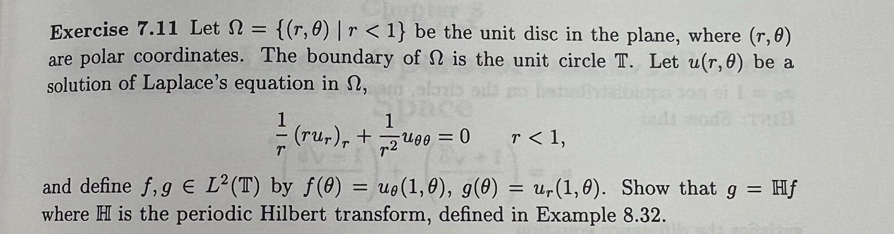
Example

